Slide 1

Strategy and applications
Chapter 5
Digital business strategy
Part-1

Slide 2
Learning outcomes
Follow an appropriate strategy process model for digital business
Apply tools to generate and select digital business strategies
Outline alternative strategic approaches to achieve digital business.

Slide 3
Management issues
How does digital business strategy differ from traditional business strategy?
How should we integrate digital business strategy with existing business and information systems strategy?
How should we evaluate our investment priorities and returns from digital business?

Slide 4
Michael Porter on the Internet
‘The key question is not whether to deploy Internet technology – companies have no choice if they want to stay competitive – but how to deploy it.’
Porter, M. (2001) Strategy and the Internet,
Harvard Business Review, March 2001, 62–78.

Slide 5
Strategy
Strategy defines the future direction and actions of an organisation defined as approaches to achieve specific objectives.
Alternative definitions of Strategy:
‘Defines how we will meet our objectives’
‘Sets allocation of resources to meet goals’
‘Selects preferred strategic option to compete within a market’
‘Provides a long-term plan for the development of the organisation’.

Slide 6
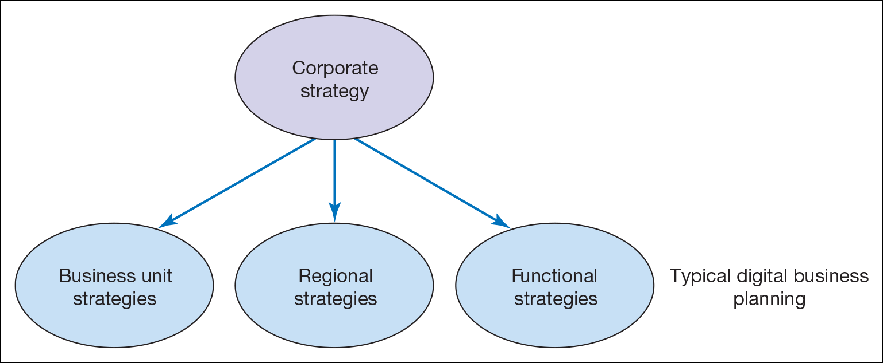
Different forms of organisational strategy
Corporate Strategy- concerned with the overall purpose and scope of the organisation
Business unit strategy – defines how to compete successfully in a particular market, and operational strategies, which are concerned with achieving corporate and business unit strategies
Functional strategies – describe how the corporate and business unit strategies will be operationalized in different functional areas or business processes.
Functional and process strategies refer to marketing, supply chain management, human resources, finance and information system strategies.

Slide 7
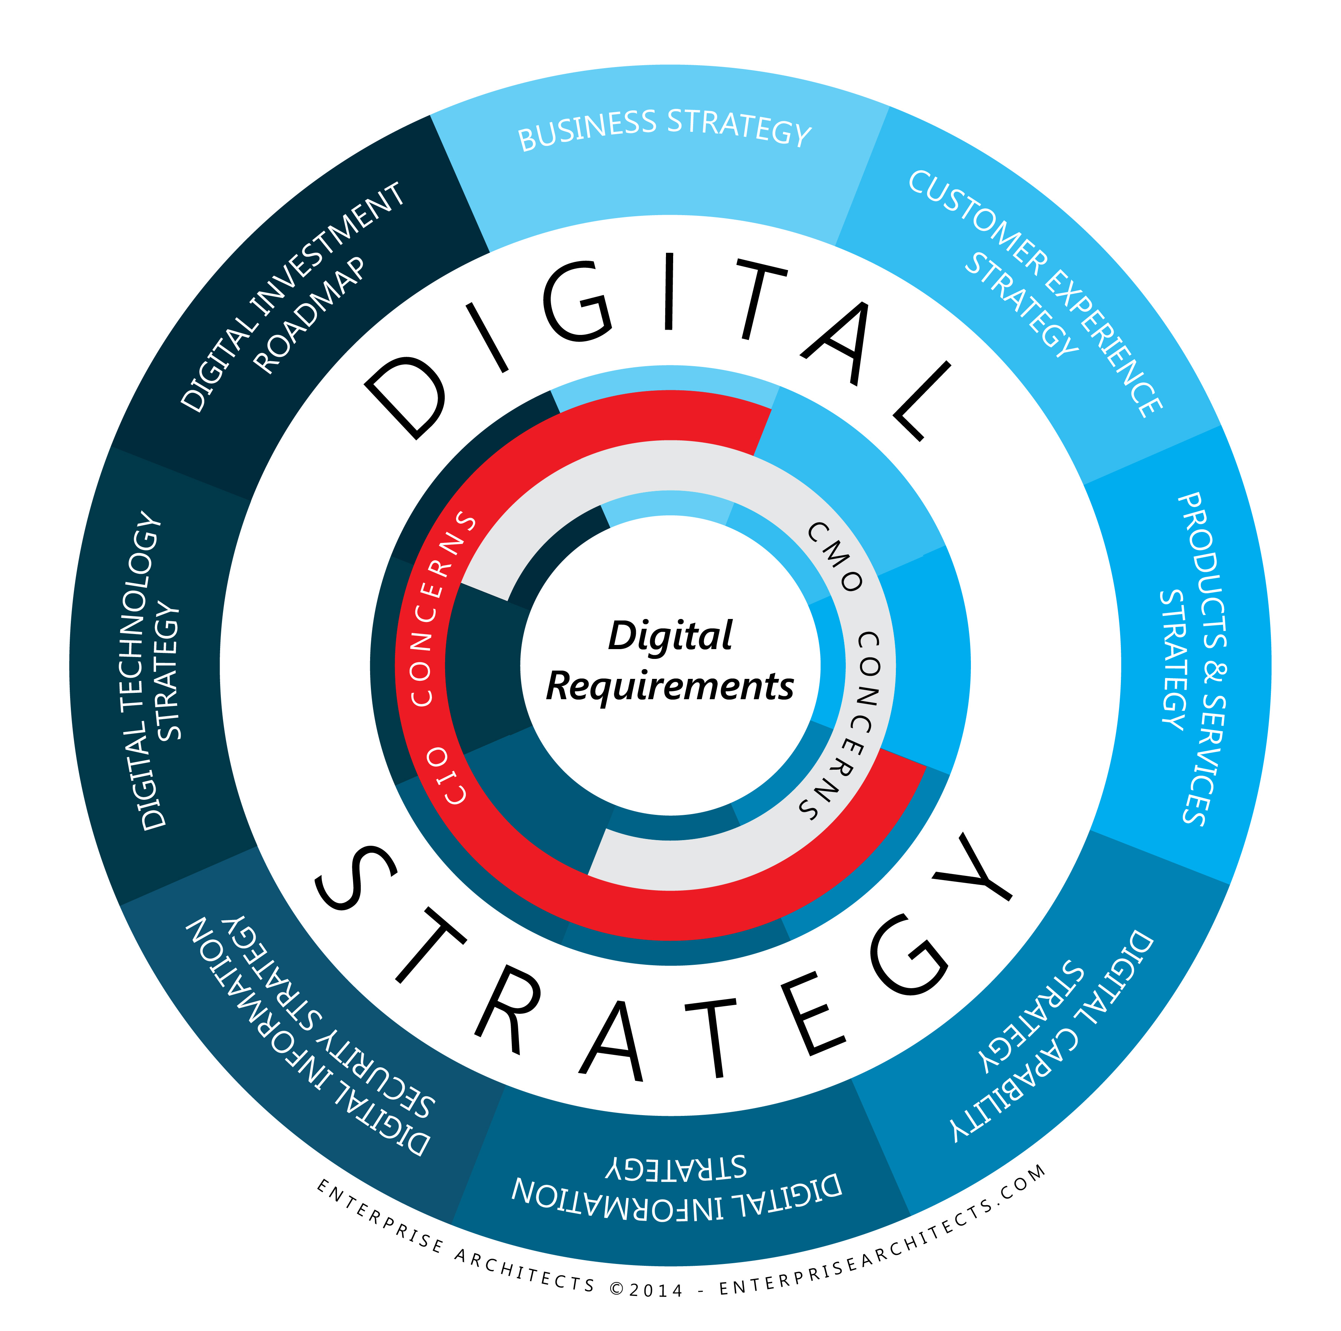
Digital Business Strategy
The approach by which the application of new technologies to existing business activities can support and influence business strategy and provide competitive advantage.
Where this will fit in the organisation?
This must be discussed and agreed. However, the tendency is to be incorporated within the functional strategies, for example within a marketing plan or logistics plan or as part of information systems.
DB strategy must be based on corporate objectives.
They must be based on new opportunities and threats related to digital network adoption, which are identified from environmental analysis.

Slide 8

What happens where there is no digital business strategy?
Missed opportunities for additional sales on the sell-side and more efficient purchasing on the buy-side
Fall-behind competitors in delivering online services – may become difficult to catch-up, for example, Tesco, Dell
Inappropriate direction of digital business strategy, poorly defined objectives, for example, with the wrong emphasis on buy-side, sell-side or internal process support
Limited integration of digital business at a technical level, resulting in silos of information in different systems
Resource wastage through duplication of digital business development

Slide 9
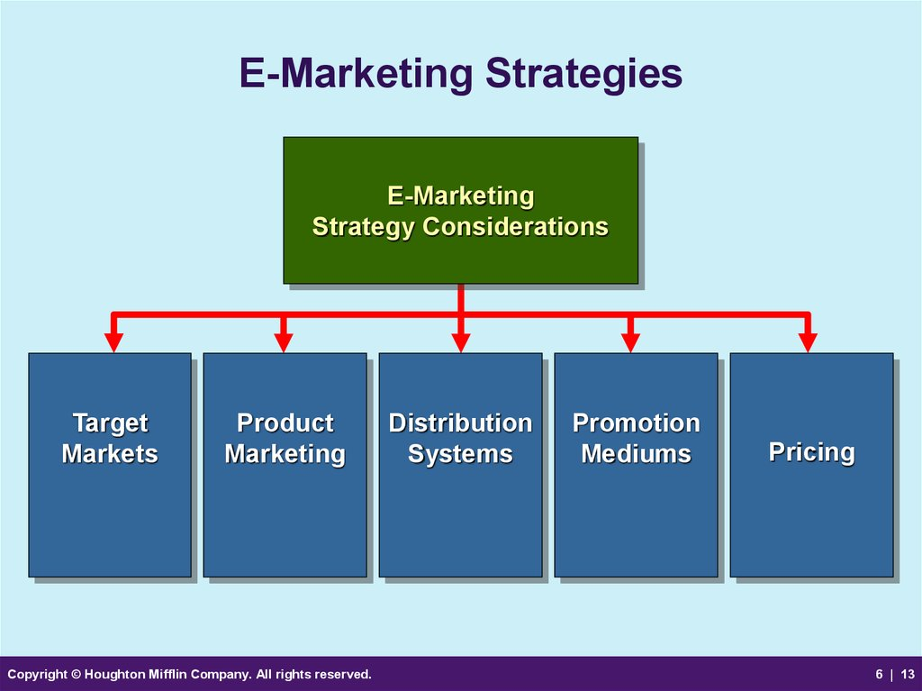
Sell-side e-commerce strategy or e-marketing/CRM strategy
Sell-side e-commerce is a channel strategy
Objectives for online contribution percentage should drive our strategy
Our e-commerce strategy defines how we should
Hit our channel leads and sales targets
Acquisition, Conversion, Retention, Service, Profitability
Communicate benefits of using this channel
Prioritise products available through channel
Prioritise audiences targeted through channel
Select partners for this channel
Channel strategy thrives on differentials
But, need to manage channel integration.

Slide 10
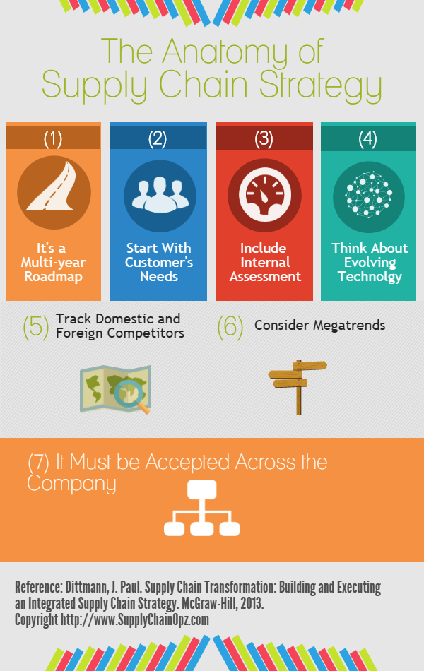
Buy-side e-commerce strategy (Chapters 6 and 7) or e-supply chain management strategy
Buy-side e-commerce strategy is about maximising operational efficiencies while improving customer service quality
Operational efficiency KPIs should drive our strategy
Our buy-side e-commerce strategy defines how we should
Automate internal processes
Link internal resource management systems with external purchasing systems
Prioritise suppliers/partners collaborating using this channel
Prioritise applications for SCM – create a roadmap
Involves selection of appropriate strategic partners.

Slide 11
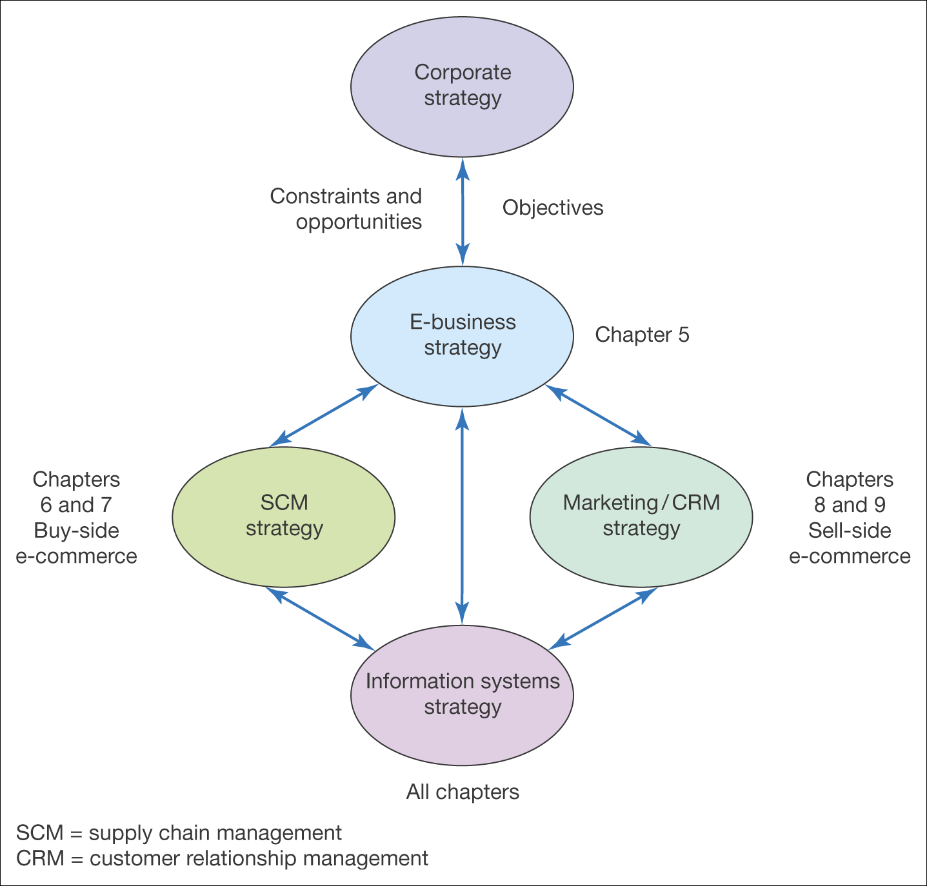
Figure 5.2 Relationship between digital business strategy and other strategies

Slide 12
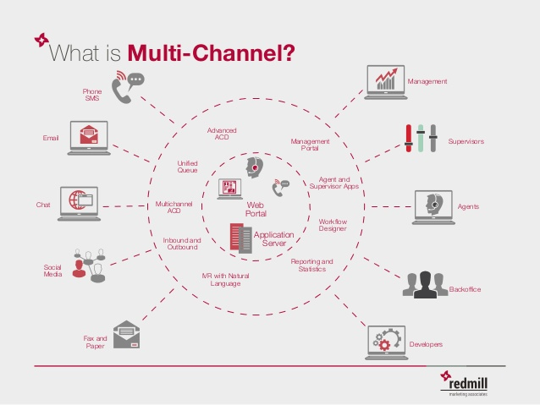
Digital channel strategies(DCS)
DCS define how a company should set specific objectives and develop specific differential strategies for communicating with its customers and partners through electronic media.
Examples of DCS include:
Overarching digital channel or multichannel strategy with specific channel strategies
Mobile commerce strategy
Social media strategy
Social CRM strategy
SCM or ERP strategy
E-procurement strategy
Notes:
To prevent simply replicating existing processes through digital channels, which will create efficiencies but will not exploit the full potential for making an organisation more effective by utilizing digital technologies.

Slide 13
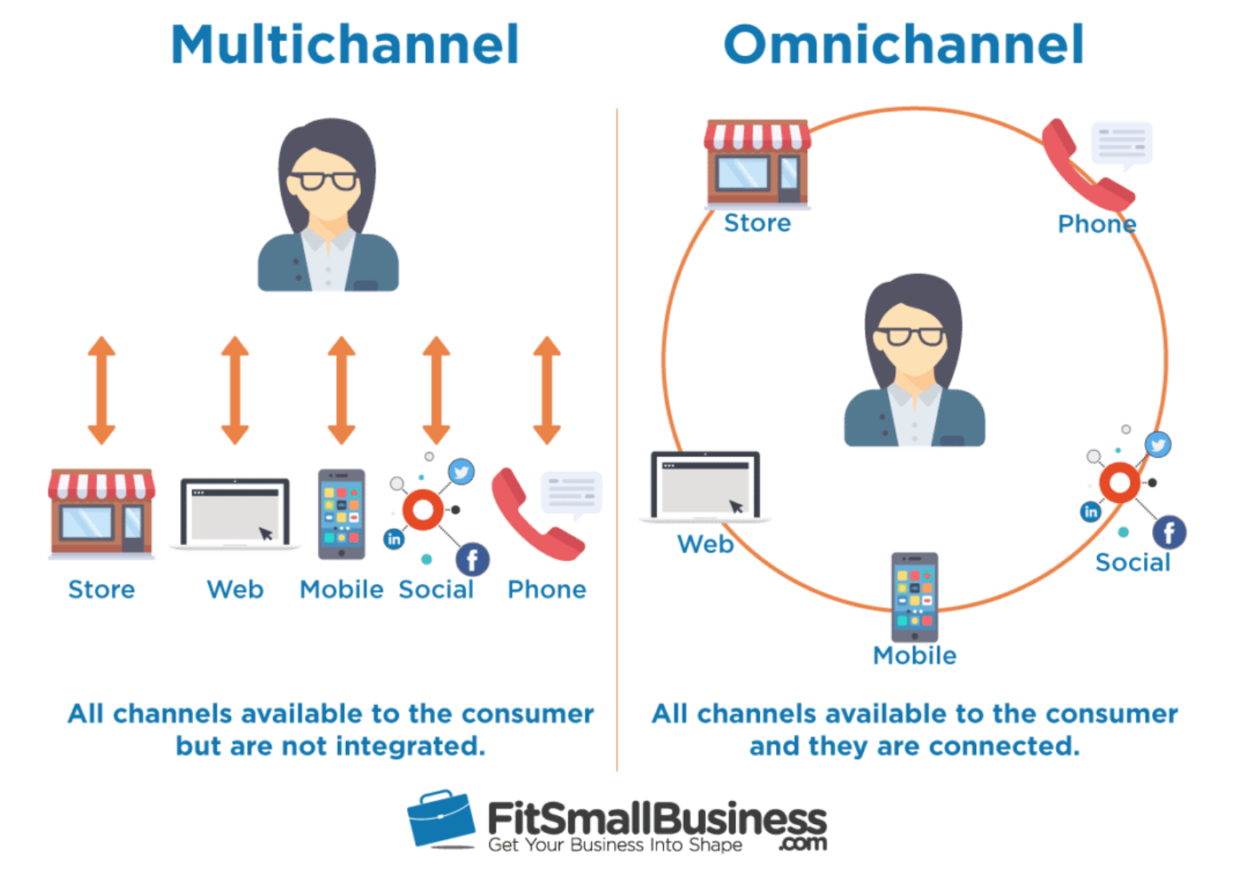
Digital channel strategies(DCS)
Multichannel digital business strategy
Defines how different marketing and supply chain channels should integrate and support each other to drive business efficiency and effectiveness.
Omnichannel business strategy
This is a cross-channel business model that organisations can use to provide their user/customer experience – it provides a seamless customer experience across offline and online channels, such as, a website, telephone, bricks-and-mortar store, live web chat, mobile apps etc.
DCS also defines how an organisation gains value internally from using digital networks, such as sharing employee knowledge and improving process efficiencies through intranets etc

Slide 14
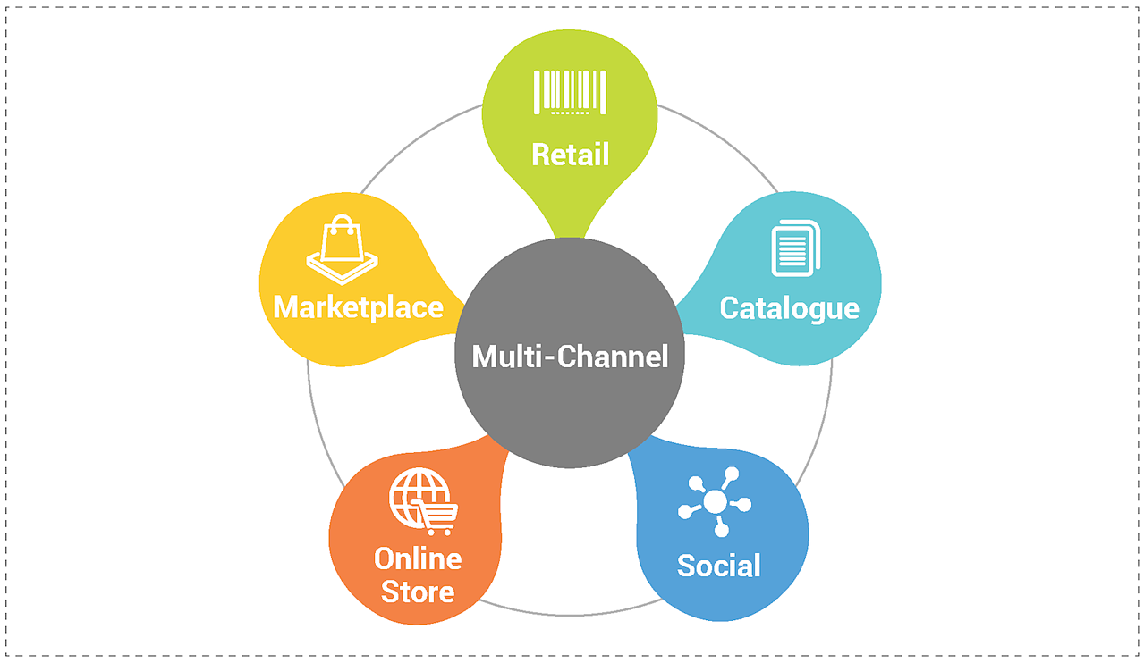
Digital channel strategies(DCS)
Main characteristics of multichannel strategy is:
Specific digital business objectives need to be set to benchmark adoption of e-channels
Digital business strategy defines how we should:
Communicate the benefits of using e-channels
Prioritise audiences or partners targeted for e-channel adoption
Prioritise products sold or purchased through e-channels
Achieve our e-channel targets
Digital channels do not exist in isolation
Also defines how an organisation gains value internally from using electronic networks.

Slide 15
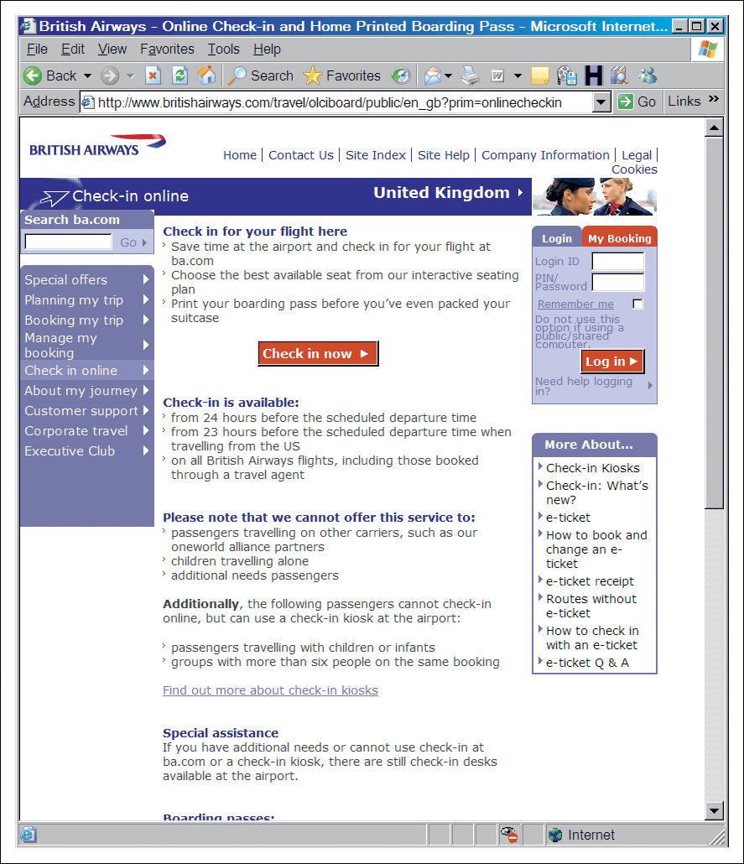
BA asks: ‘Have you clicked yet?
’In 2004, BA launched online services which allowed customers to take control of the booking process, so combining new services with reduced costs. BA decided to develop a specific online ad campaign to create awareness and encourage usage of its Online Value Proposition(OVP)
Figure 5.3 BA communicates its online value proposition
Source: Based on Revolution (2005); wwwbritishairways.com

Slide 16
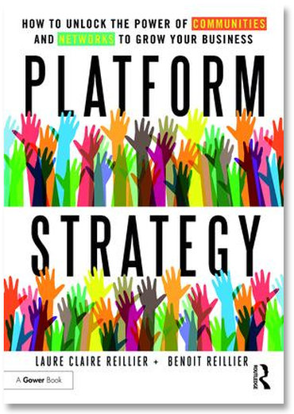
Platform Strategy
This is about entering a market that revolves around allowing platform participants to benefit from the presence of others i.e. creating community.
Ex: Google, eBay, Facebook, video gaming platform etc, are about co-creating value
Platforms also rely on the power of ’network effects’.
Three technologies have risen the platforms:
Cloud, Social and Mobile
Platform strategy is determined by three things: (Bonchek and Choudary, 2013):
Connection: how easy is it for others to use/join the platform and share/transact
Gravity: how well the platform attract participants (producers and consumers)
Flow: how well the platform foster the exchange and c-creation of value?

Slide 17
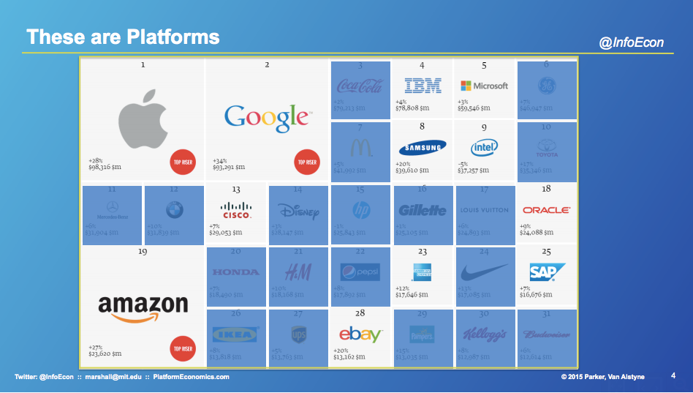
Common types of Platforms
Hagel(2015) says that there are THREE common types of platforms:
Aggregation platforms:
They bring together a broad array of resources and help users connect with them.
Data/information aggregation, such as scientific databases
Marketplace/broker platforms, such as MoneySuperMarket, AppStore, eBay
Contest platforms, where people can post a problem and offer a reward/payment to the user with best solution. E.g. InnoCentive and Kaggle
Social platforms: They bring a lot of people together with common interest
Mobilisation platforms
They are about moving people to act together to accomplish something beyond an individual participant. E.g. Crowdsourcing(crowdfunding), such as CrowdFunder.co.uk, kickstarter.com etc, justgiving.com

Slide 18
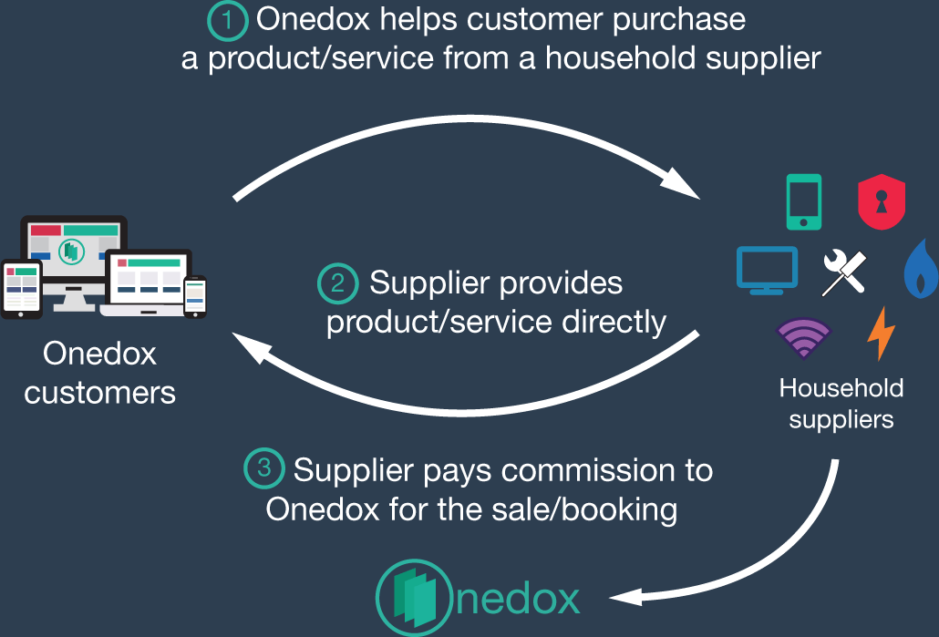
Figure 5.4 The Onedox revenue model
An example of how start-up company Onedox.com worked on defining its digital business strategy and used the crowdfuncding platform Crowdcude to raise money.
(Onedox closed in Dec 2019)
Source: https://www.crowdcube.com/companies/onedox/pitches/b9nE7q#categorise

Slide 19
Strategy process models for digital business
Strategy process model is a framework for approaching strategy development.
Framework gives a logical sequence to follow to ensure inclusion of all key activities of business strategy development, also can be evolved as part of a process of continuous improvement.
Common elements include:
Internal and external environment scanning or analysis.
A clear statement of vision and objectives
Strategy option generation, evaluation and selection
Enactment of the strategy as implementation
Control is required to monitor operational and strategy effectiveness problems and adjust the operations or strategy accordingly.

Slide 20
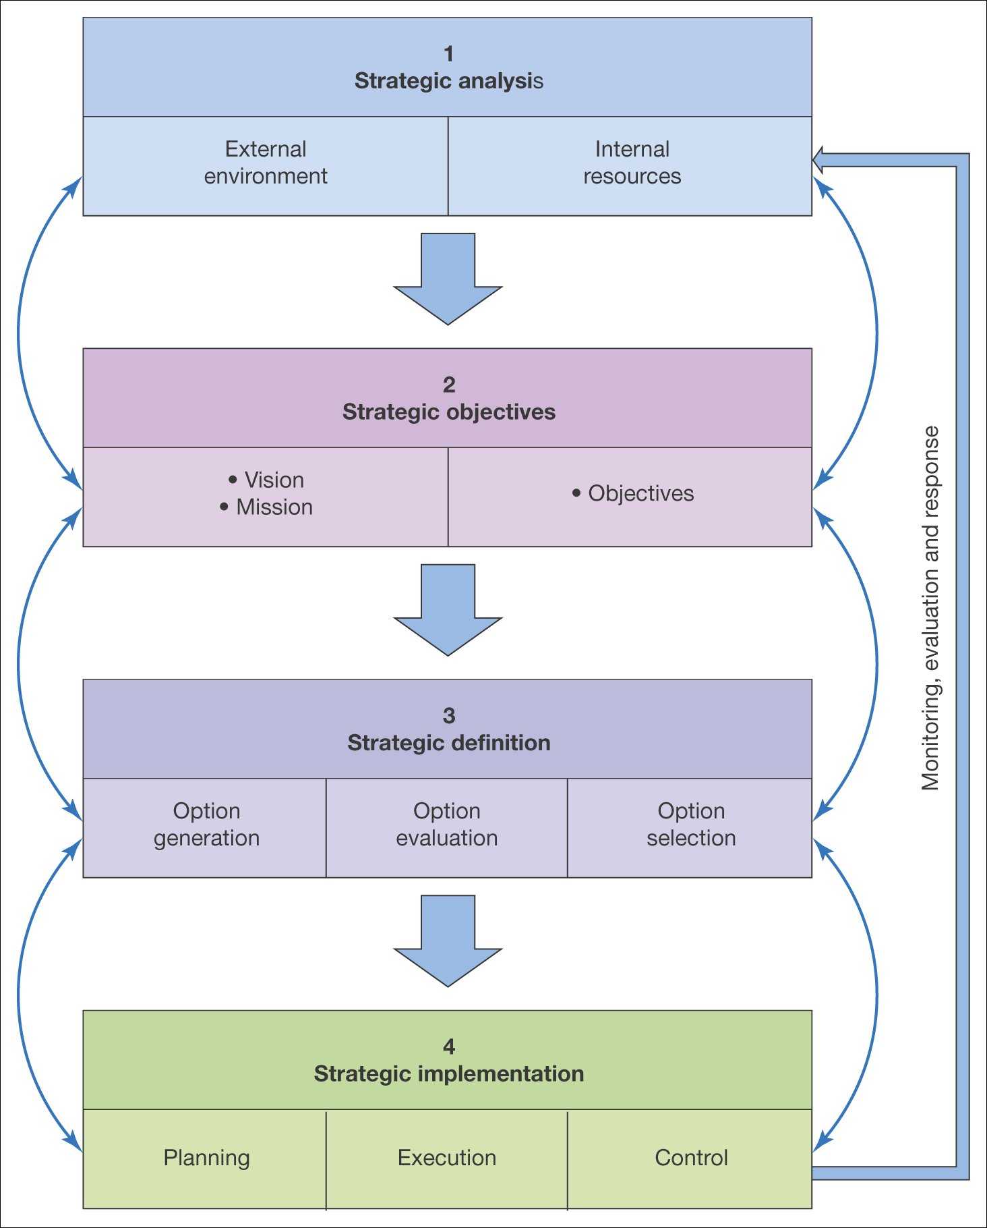
Figure 5.4 A generic strategy process model

Slide 21
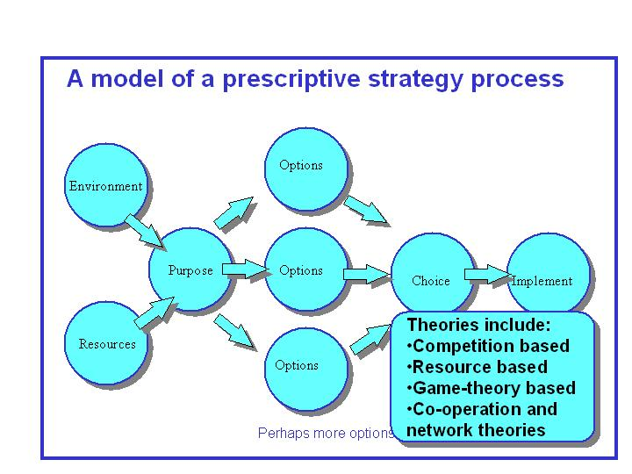
How strategy process models are applied
The arrows in the generic strategy process model highlight an important distinction in the way in which strategy process models are applied.
Two approaches:
Prescriptive strategy approach
Strategic analysis, development and implementation are linked together sequentially and is a linear and rational process, starting with where-are-we and then developing new strategies for the future. Thus strategy is prescribed in advance.

Slide 22
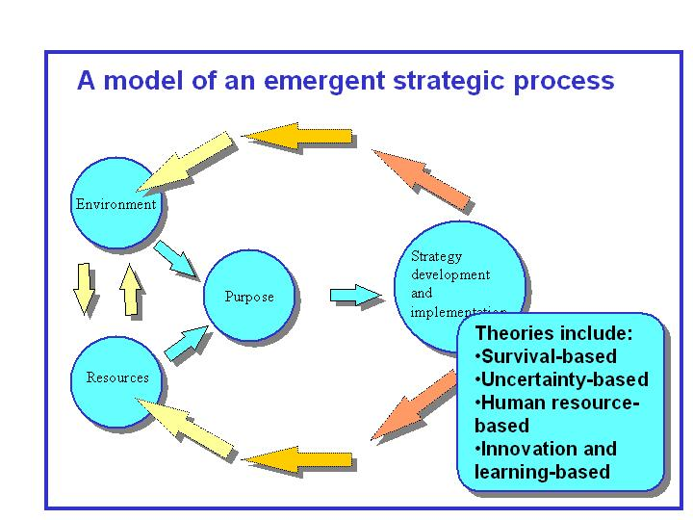
How strategy process models are applied
Emergent strategy approach
Strategic analysis, strategic development and implementation are interleaved and developed together, adapting to human needs and continuing to develop over time. Thus strategy is evolving, incremental and continuous, and therefore it is hard to summarise into a plan
However, in reality, in most strategy development and planning process have elements of both.

Slide 23
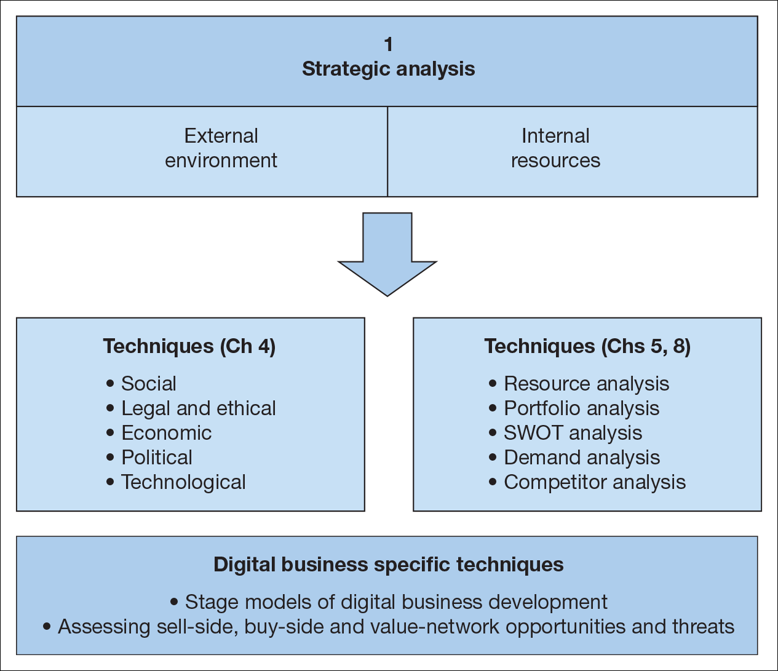
Figure 5.6 Elements of strategic situation analysis for the digital business

Slide 24
Strategic Analysis
Strategic analysis involves a review of:
Internal processes and resources to assess company’s digital business capabilities and results to date in the context of a review of its activity in the marketplace.
The immediate competitive environment (micro-environment) including customer demand and behaviour, competitor activity, marketplace structure and relationships with suppliers, partners, intermediaries
The wider environment(macro-environment) in which a company operates. This includes the social, legal, economic and political factors

Slide 25
Resource and Process Analysis
Resource Analysis is the review of the technological, financial and human resources of an organisation and how they are utilized in business processes.
Resources are the tangible and intangible assets which can be used in value creation
Capabilities represent the ability of a firm to use effectively to support value creation.
They are dependent on the structure and processes used to manage digital business.

Slide 26
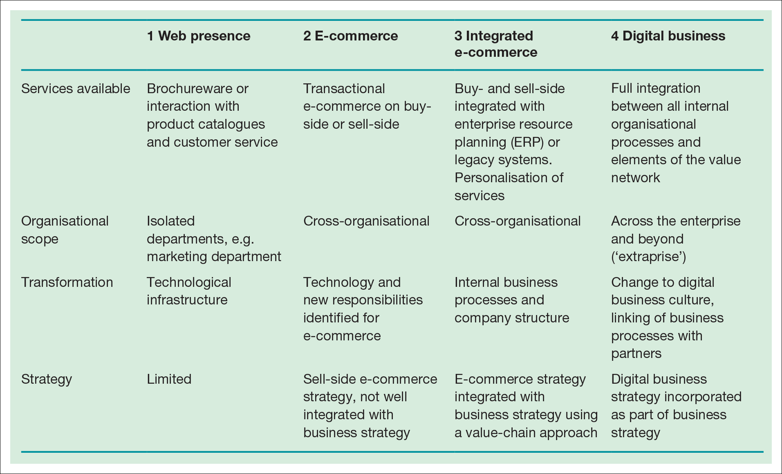
Stage models
Helpful in reviewing how advanced a company is in its use of ICT resources to support its processes
Table 5.3 A stage model for digital business development

Slide 27
Application Portfolio Analysis
Analysis of the current portfolio of business applications within a business is used to assess current information systems capability and also to inform future strategies.
The six areas of benchmarking in portfolio analysis are:
Digital channel strategy
Online customer acquisition
Online customer conversion and experience
Customer development and growth
Cross-channel integration and brand development
Digital channel governance

Slide 28
Boncheck, M. and Choudary S.P.(2013), Three elements of a Successful Platform Strategy. Harvard Business Review.
Hagel, J. (2015) The Power of Platforms. Accessed on 07 April 2020. Available at: https://www2.deloitte.com/global/en/insights/focus/business-trends/2015/platform-strategy-new-level-business-trends.html

